Slide 1
Sagas Camunda VS Zeebe
Implementation of a complex distributed transaction involving several microservices

Slide 2
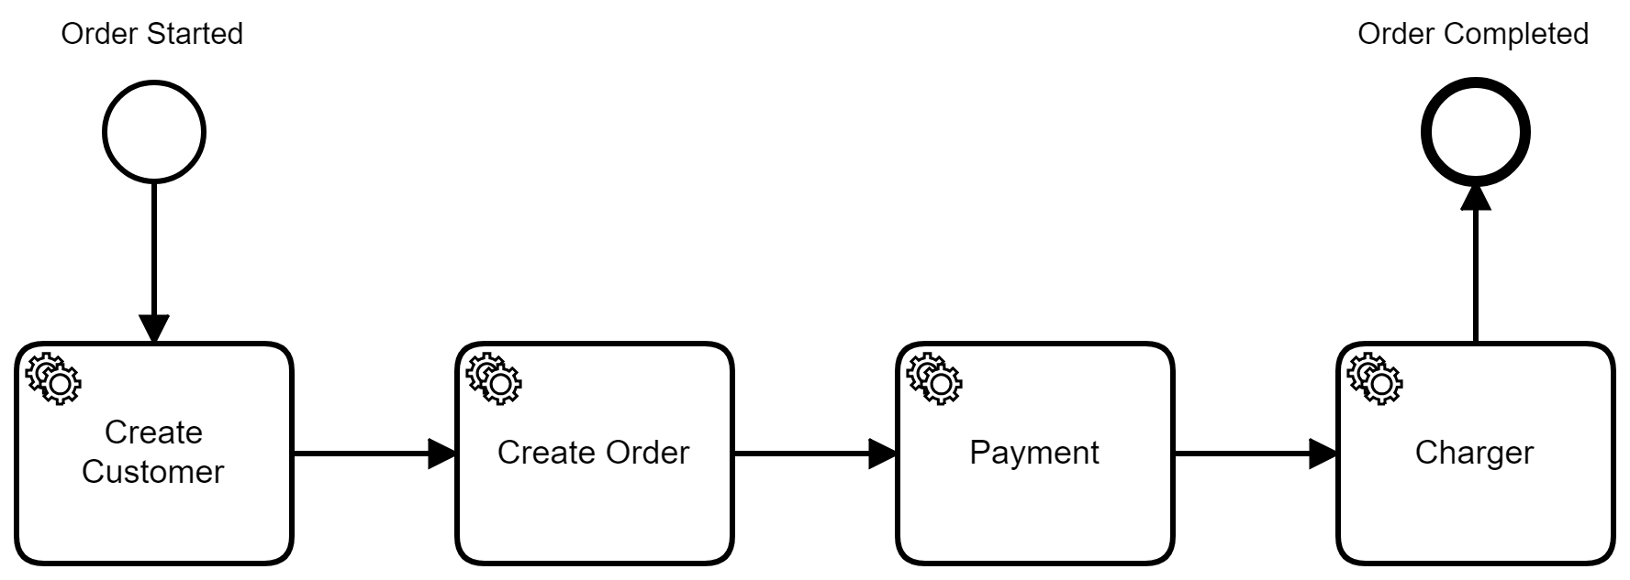
Camunda BPMN model

Slide 3
How Camunda implementation works
No Java code needed
Uses the Connector feature of Camunda (http-connector), this is what actually makes the HTTP calls
Request and Response parsing is required to work on the variables needed for each call
Javascript was used for the above parsing

Slide 4
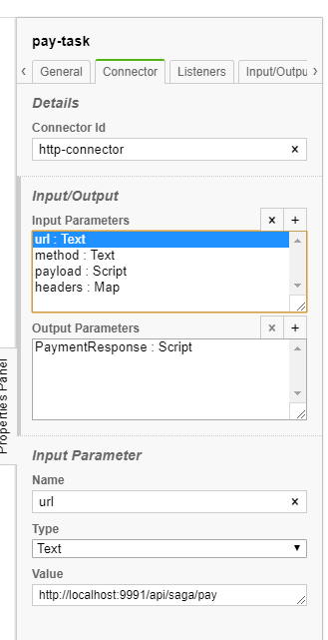
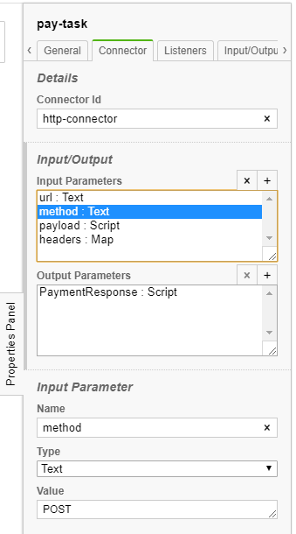
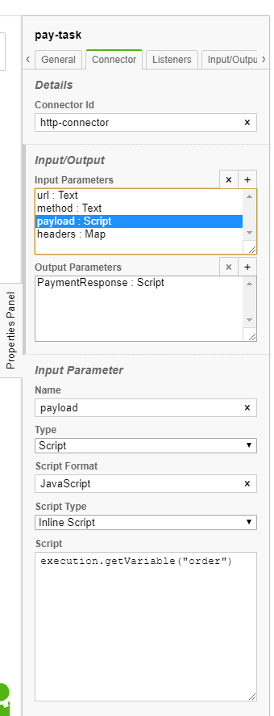
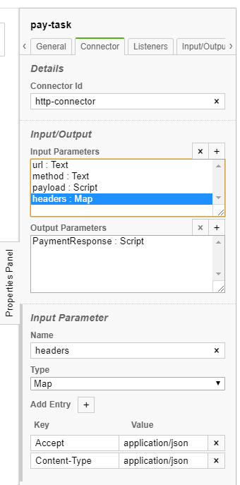
Configuration of a HTTP request

Slide 5
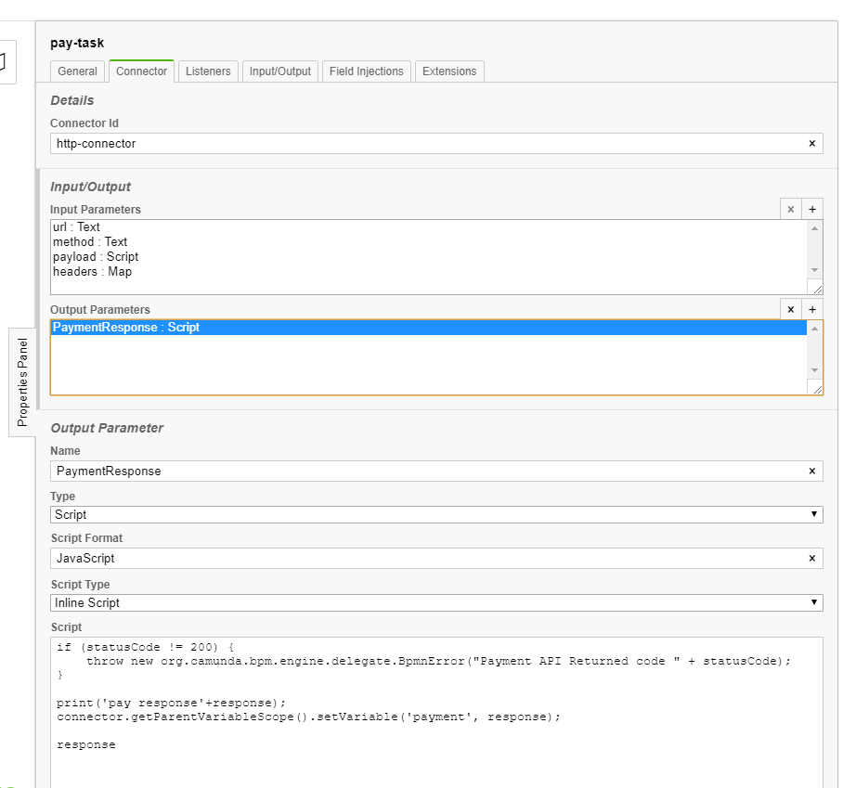
Configuration of a HTTP response
The inline script has predefined variables to access the response, statuscode
The inline script can throw errors to indicate that compensating actions must be called by Camunda
There is a var called ‘connector’ which gives access to the current workflow instance
At the end of the script the response is returned and stored in ‘PaymentResponse’ variable that could be used in the next workflow task

Slide 6
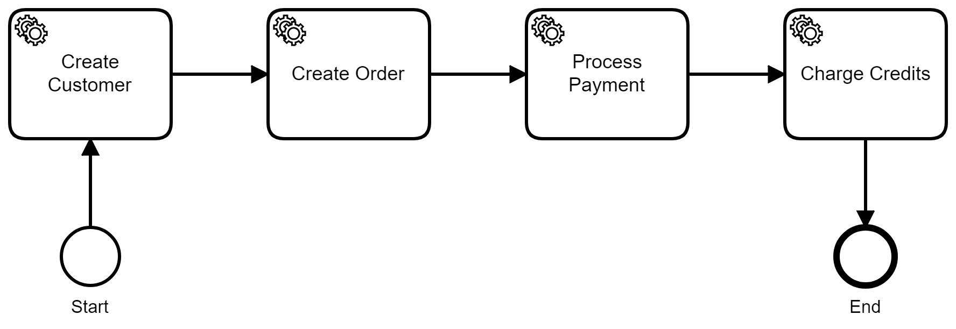
Zeebe BPMN model

Slide 7
How Zeebe implementation works
Each Task is mapped to a Zeebe Worker, which is our Java code that is called by Zeebe and executes some logic
In our case this logic is calling the microservices and parsing request/response variables
In the end, the code that was written in Javascript in the Camunda implementation, is written in Java in the zeebe impl.

Slide 8
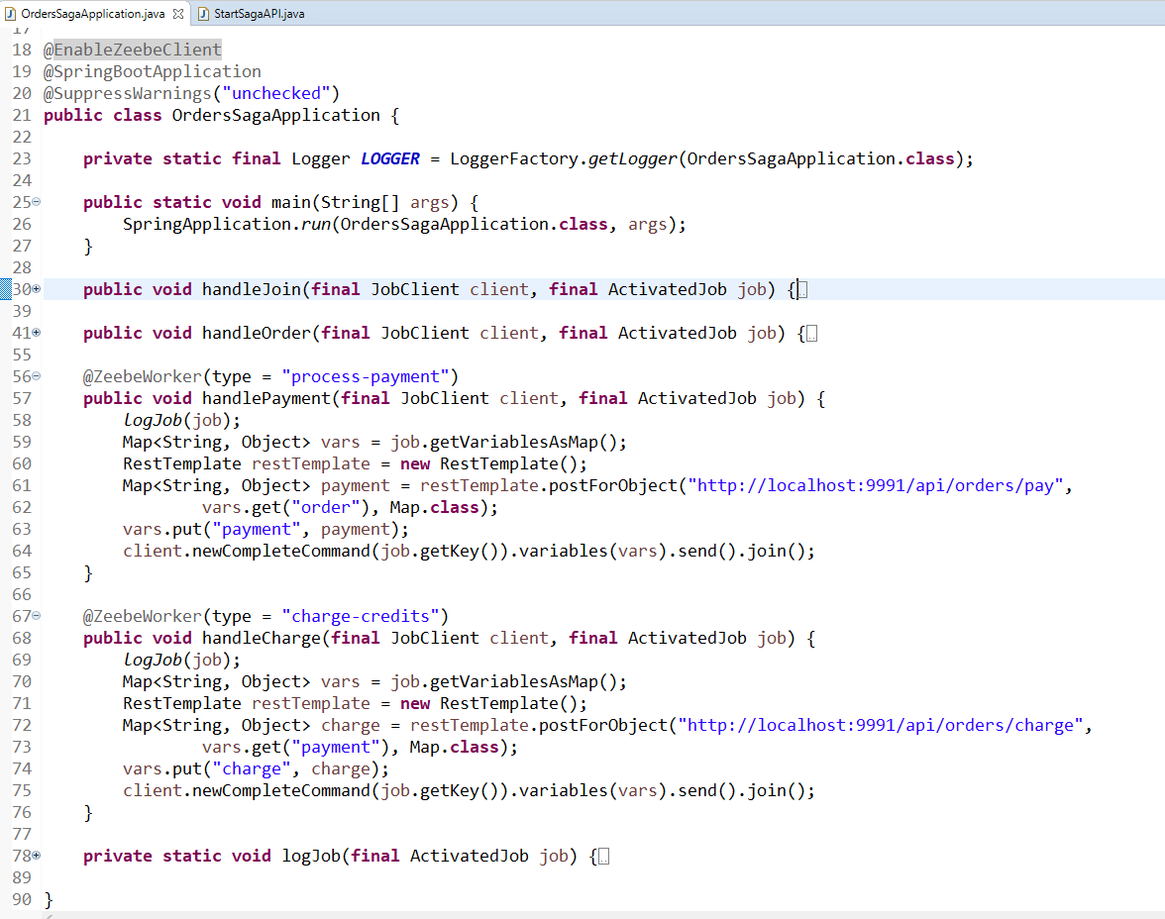
The zeebe client lib is a Spring Boot starter package
Each Task in the workflow is a @zeebeworker
Each Task will call the actual microservice and provide the necessary variables and response parsing
Errors can be throw from the Java code, which will trigger compensating actions by zeebe
This code glues the http-connector and Javascript parsing that was in the Camunda impl

